Slide 1
PHYS 304: Lecture 2 (Intro to) Quantum Mechanics
Sept-Dec 2021 Edition
Jeff Young
brimacombe Rm 278, Young@phas.ubc.ca

Slide 2
Lets have some fun!

Poll #1:
In classical physics light is treated as/considered a Q1
In classical physics an electron is treated as/considered a Q2 .
What evidence is there for light behaving both as a particle and a wave? Q3
What evidence is there for electrons behaving as both a particle and a wave? Q4
Bottom Line:
Most of our encounters with light can be “explained” or modelled using classical wave mechanics.
Most of our encounters with electrons can be “explained” or modelled using classical mechanics.
But in general, both can behave “like waves” or “like particles”, depending on the problem at hand.
Notes:
For Q1 should be quick: Q2 can discuss answers after having gone through the Quantum Optics discussion…verify understanding, and see if anyone has another answer (photo-electric effect)…discuss the photoelectric effect
Q3: will take more discussion…do as Think Pair Share exercise. Start by asking them what classically characterizes waves….wavelengths, travelling waves, INTERFERENCE. Get them to remember the double slit interference pattern with either light or water waves. Then build on INTERFERENCE to go over Waterloo electron single and double slit paper from 2013 (Bach et al) http://iopscience.iop.org/article/10.1088/1367-2630/15/3/033018/pdf

Slide 3
Review of Key points from last day
Quantum mechanics is mysterious, in large part due to the intrinsic uncertainty in a system’s behaviour, distinct from statistical or measurement uncertainties.
Waves are distributed displacements of some quantity in space and time.
Pure waves have well-defined wavelengths and periods, or frequencies.
Interference, or the superposition of distinct distributed displacements, in some sense defines “wavelike behaviour”.
Notes:
Remind them quickly that the Bach paper describes experiments where diffraction patterns are observed on electron detector screens that record individual electron arrivals, when averaged over a long time (many many electrons incident on the electron-double slit.
Emphasize “wavelike” equivalent to “interference” or “delocalized disturbances”, while “particle like” associated with “localization”.

Slide 4
Today’s activities
Review and reflect on how a classical particle kinetics problem is solved.
Introduce the fundamental postulates of the quantum mechanical approach to solving particle kinetic problems.
Contrast the two approaches, from both mathematical and conceptual perspectives.

Slide 5
Use a particle moving in 1 dimension in a time-independent potential as the basis for learning how to treat an object quantum mechanically
(Slightly easier than starting from waves, for technical reasons, and familiarity)
Lecture 2, Activity #1
Remind yourselves how to classically solve for the motion of a particle with mass m travelling in the positive x direction with a speed of 100 m/s if it was at position x=0 at time t=0, and there is a uniform electric field exerting a force on the electron of 1 N in the negative x direction.
Think on your own, and in pairs for a couple of minutes. (Think, Pair, Share (TPS))
Notes:
[15 minutes] Go over the fully deterministic Newtonian equation of motion

Slide 6



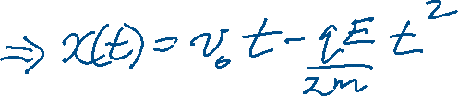


Lecture 2, Activity #1
Notes:
Sketch motion to right, then eventually to left.
Emphasize that implicitly x represents the centre of mass of the particle, which doesn’t change size/shape, and explicitly, x = x(t): the centre of mass of the particle depends on time, and that the solution describes.

Slide 7

Lecture 2, Activity #2 (Rapid-fire response)
In Quantum Mechanics, in contrast to solving equations for x(t) directly, what does one have to find in order to calculate x(t), v(t) etc. for the electron?
The wavefunction of the electron: Ψ(x,t)
What is the differential equation “analogous to” $m\frac{d^{2}x(t)}{{dt}^{2}}=F(x)=−\frac{d}{dx}V(x)$, one needs to solve to find the wavefunction?
How is the QM scenario operationally similar to the classical case?
How is the QM scenario mathematically different from the classical case? (insert the arguments of the wavefunction and potential explicitly) The “x” in Newton’s equation is entirely different from the “x” in Schrödinger’s equation!
Notes:
[5 min] Ask how this is conceptually similar to the classical solution: Ans: a prescription for “deriving everything there can possibly be known about the particle’s future dynamics”.
Ask them what the biggest difference between the two equations of motion are, mathematically? Ans: partial differential equation for quantity that depends on x and t. vs a simple differential equation for a variable that depends only on t.
Get them to write out explicitly, the implicit dependencies of psi and V. Ask them what the biggest difference is conceptually: Ans: x is a parameter of psi, along with t, not an explicit dynamical variable, e.g. the x in this equation is not x(t).

Slide 8
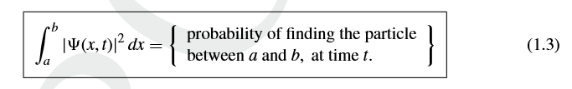
Lecture 2, Activity #3 (TPS, 2 mins)
What connects the quantum mechanical wave function with the classical quantity x(t)?
Notes:
[15 mins] VERY IMPORTANT CONCEPT WARNING!!!!
- Get to answer within 5 min, TPS, then
- Sketch an electron “blob” in psi^2(x,t) at two values of t.
- Go through case where localization reasonably high, so ‘particle like’, vs delocalized, ‘wavelike’. First instance velocity has trivial connection to classical particle motion; the latter?? More like a wave propagation velocity (will sort this out later).
- Emphasize that there is a large underlying uncertainty in psi itself (due to phase), if only work with psi^2.

Slide 9
Lecture 2, Activity #4 (rapid fire response)
What is the most likely location you would measure an electron to be at t=1 s if Ψ (x,t=1s) was:
|Ψ|
0
x
-x₀
0
x₀
Arg Ψ
0
Notes:
[5 mins]
- Why aren’t the y axis values needed? (Separate answer for mag and Arg graphs)
Add the dx (associated with the resolution of your measuring apparatus), and shade in an area.
EMPHASIZE NOTION OF A PROBABILITY DISTRIBUTION

Slide 10



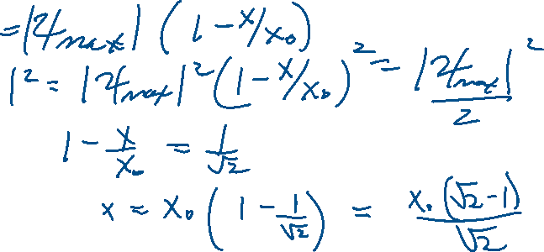
Lecture 2, Activity #5 (TPS, ~ 5 mins)
How far away from that most likely position would the probability of finding the electron be half the most likely probability?
|Ψ|
0
-x₀
0
x₀
x
Arg Ψ
0
Notes:
[15 mins] Keep sketch on blackboard or whiteboard
Obviously trick is mag squared, not mag.

Slide 11
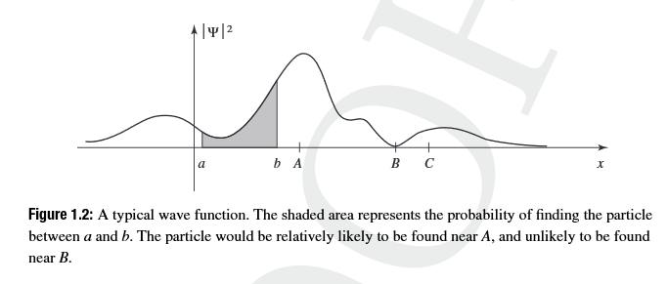
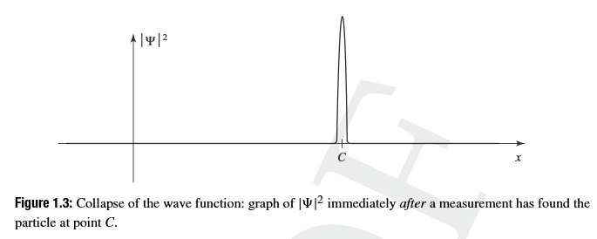
Lecture 2, Activity #6 (rapid fire response)
What would be the consequence of performing a measurement and finding the particle at location x=c, to within some uncertainty dx?
Notes:
[10 mins] Have to point out that there is a lot of residual uncertainty in psi itself (as noted above), due to unknown phase. That would have to be determined from a more detailed knowledge of how “the measurement” was performed…”measurement” is one of the most subtle aspects of QM!

Slide 12
Housekeeping
Reminder of first tutorial for everyone tomorrow at 3-4 pm. Extra tutorial will start next week.
Reminder that we will have a 10 minute Canvas Quiz at the end of Thursday’s lecture, covering last week’s lecture, and today’s material.
Reminder that Problem Set #1 due via Canvas upload of .pdf files by 9:30 AM Thursday.

Slide 13
Learning Goals (general)
After taking this course, students will be able to:
Identify when a problem requires a quantum mechanical solution.
Formulate a quantum mechanical approach to solving some simple problems.
Solve for the stationary states of some simple systems.
Construct the full temporal and spatial evolution of a system’s wavefunction (the basic formalism).
Solve some simple quantum mechanical problems analytically and (perhaps) numerically.
Understand the nature of abstract Hilbert space and its relationship to “wavefunctions” defined with respect to different system variables.
Understand the defining characteristics of the stationary quantum mechanical states of the hydrogen atom.

